Slide 1
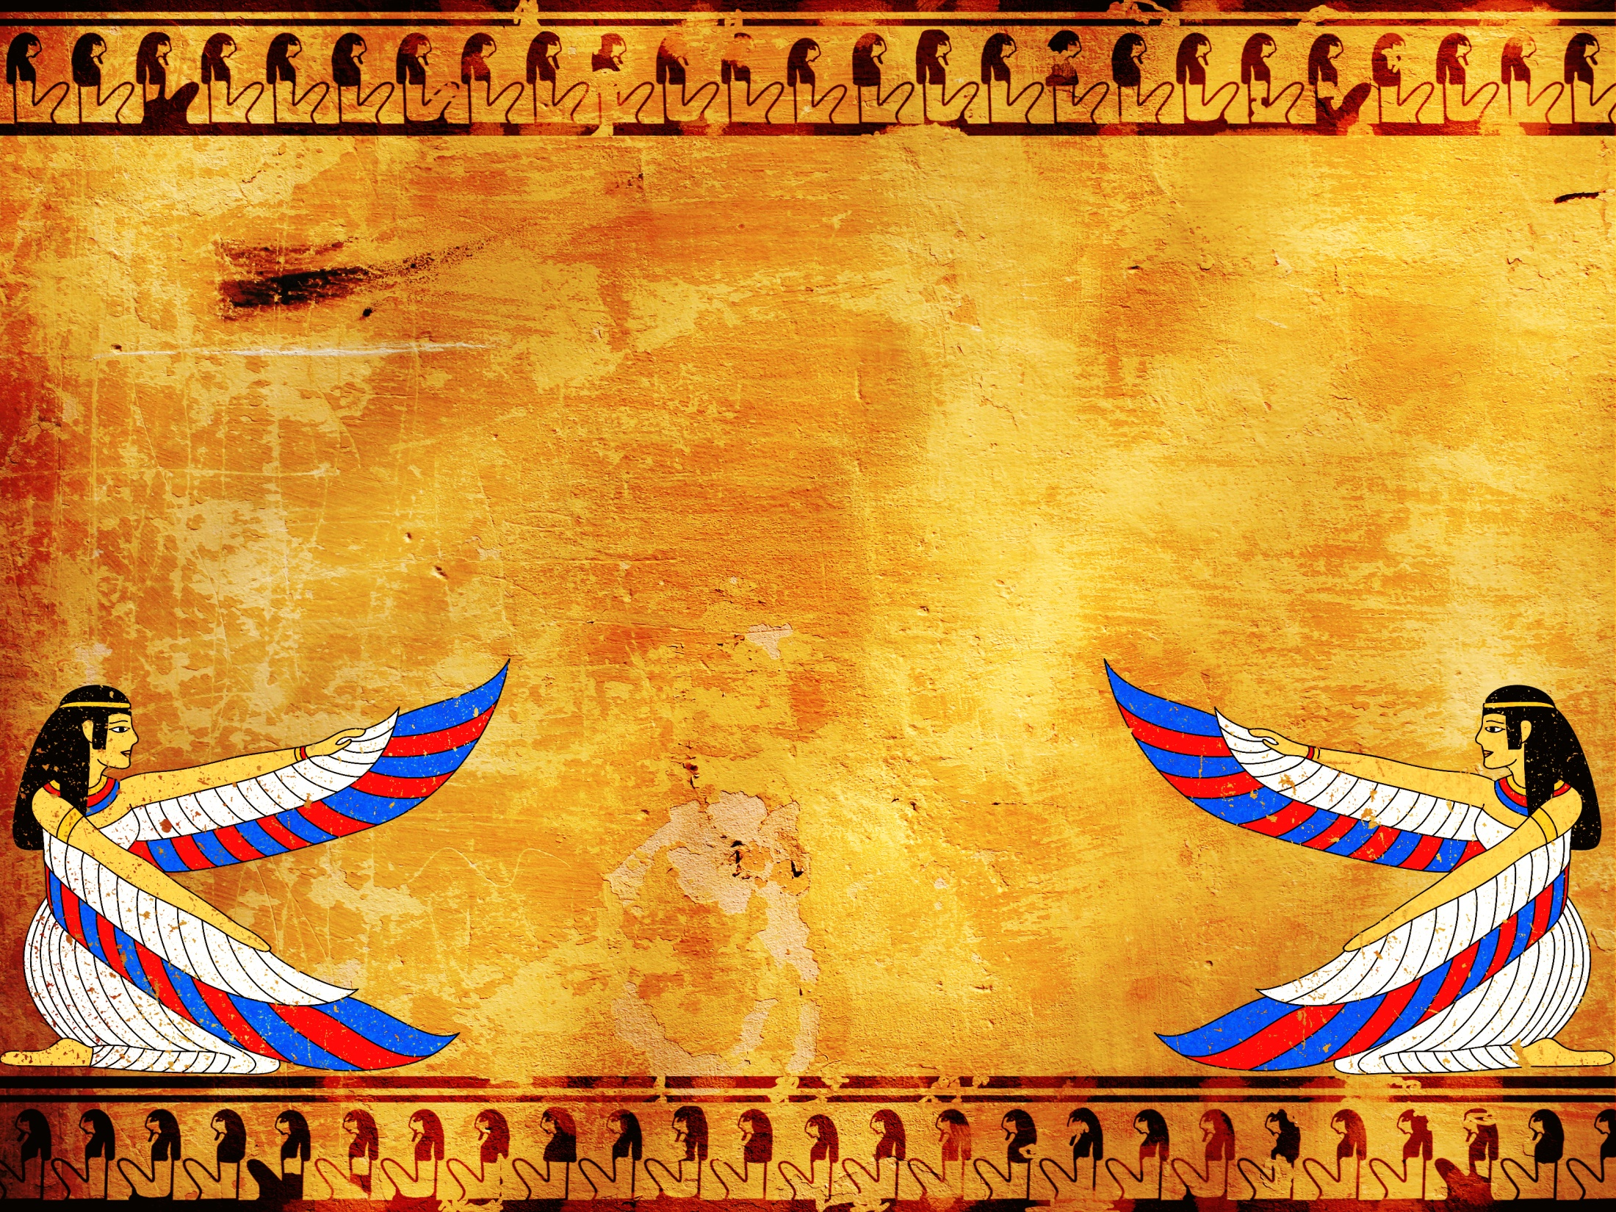
Discovering the Topic, Main Idea and Supporting Details

Slide 2
Hundreds of years ago the Rosetta Stone was discovered in the Nile Valley.

Slide 3
The Rosetta Stone helped people unlock the mystery of reading Egyptian hieroglyphics.

Slide 4
We can use the main idea of a passage as our ‘Rosetta Stone’; the main idea will aid in discovering the meaning of what we read.

Slide 5
Today we will practice unlocking the main idea of reading passages about Egypt.

Slide 6
What is main idea of a passage?
The main idea of a passage
tells what the passage is
mainly about. The main idea
is the essential message of
the passage that the author is
trying to convey to the reader.

Slide 7
How to Find the Main Idea
Read the text.
Determine the topic.
Ask yourself, “What is the author trying to tell the reader about the topic?”.
What are the details that support what you believe is the main idea?

Slide 8
It is important to note…
the main idea can be found anywhere within the passage.
the main idea may or may not be clearly stated in a sentence.
details support the main idea.

Slide 9
It is important to note…
details give more information about the main idea.
who, what, when, where, why and how questions are often supporting details.
headings, titles, and captions may provide clues about the main idea of a passage.

Slide 10
It is important to note…
The topic is the focus of the paragraph—the main idea is what the writer of the paragraph wants the reader to KNOW about the topic (focus).

Slide 11
To help organize your thoughts and determine the main idea of a passage, a main idea pyramid is helpful.

Slide 12
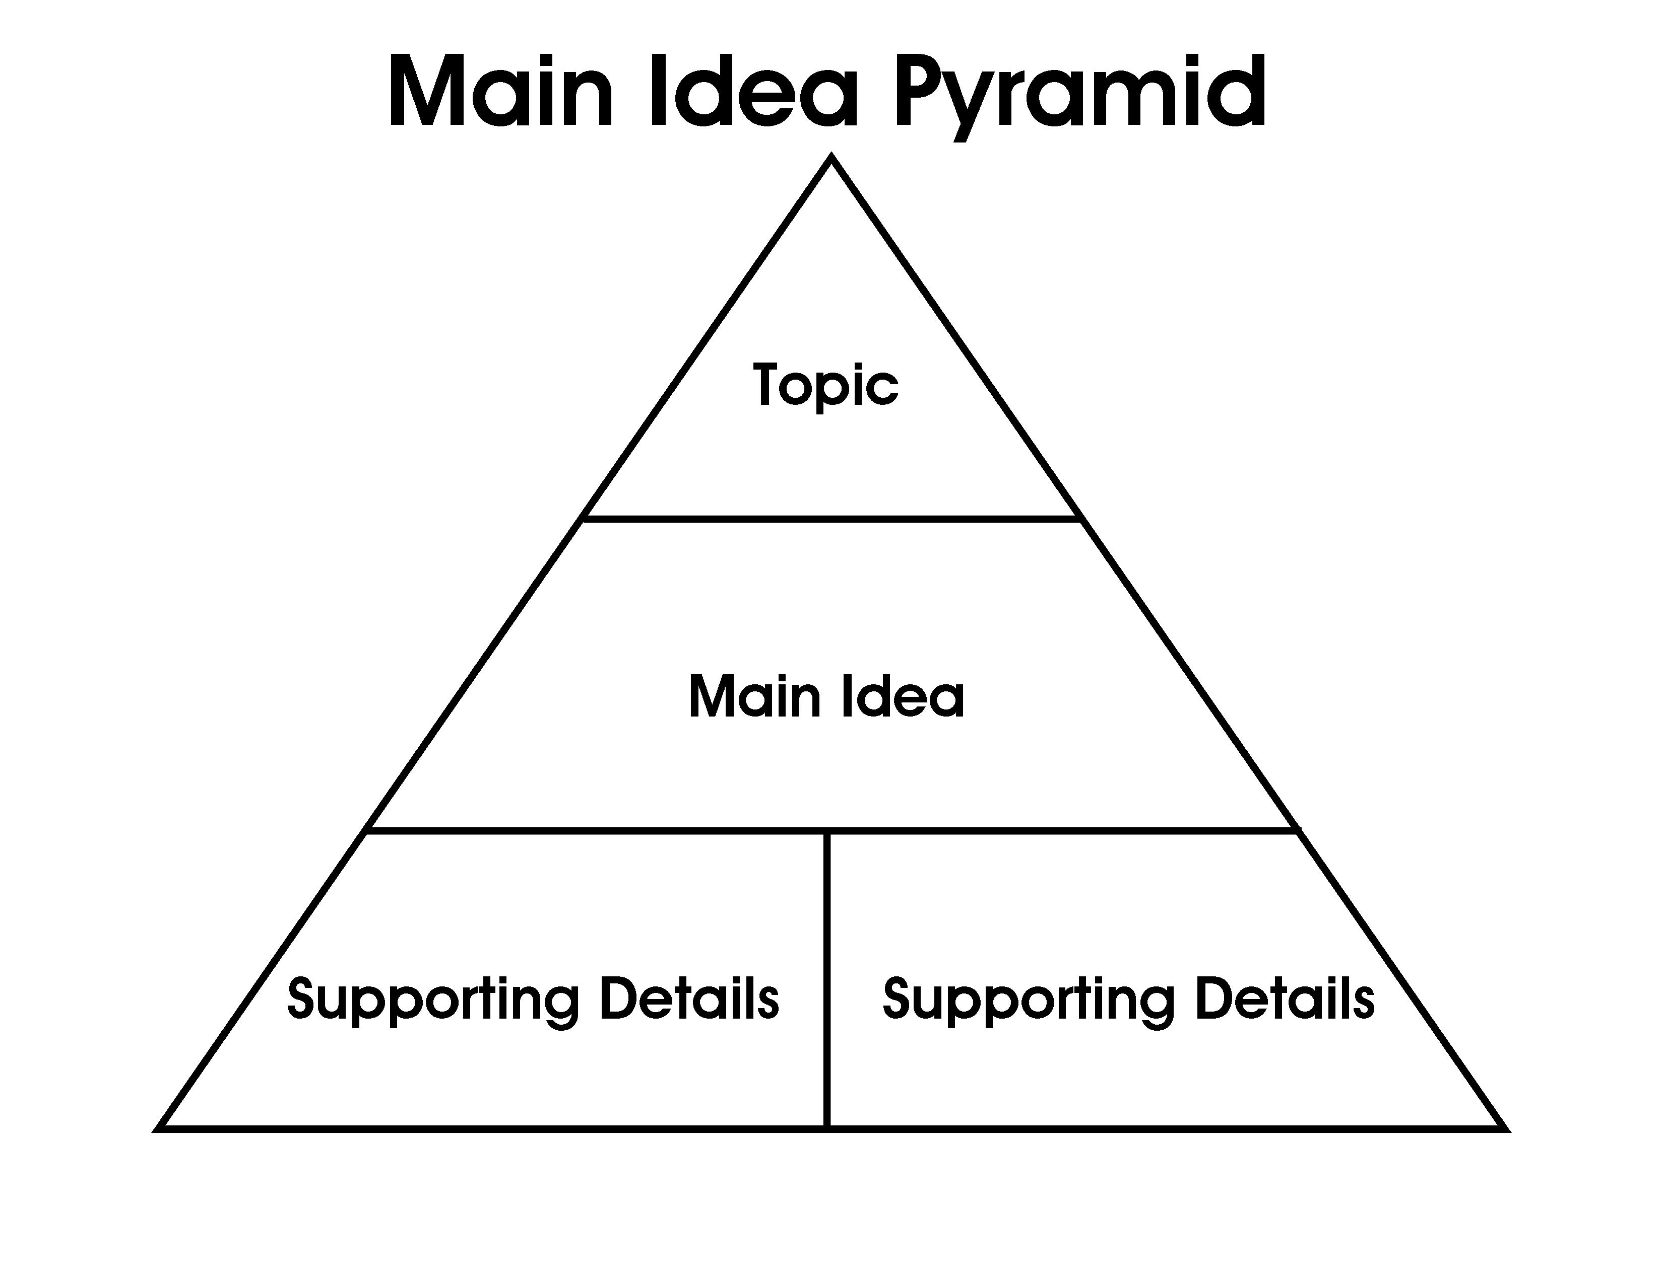

Slide 13
Let’s practice reading a passage and filling in the pyramid together.

Slide 14
Egyptology
Egyptology is the fascinating study of ancient Egypt. In order to study ancient Egypt, scientists often look at archaeological discoveries, ancient art, and hieroglyphs. When people hear the word Egyptology, many think of the famous mummy of King Tut.

Slide 15
What is the topic of the passage?
Topic
Egyptology

Slide 16
What is the author trying to tell us about Egyptology?
Topic
Egyptology
Main Idea
Egyptology is the study of ancient Egypt.

Slide 17
Which details support the main idea?
Topic
Egyptology
Main Idea
Egyptology is the study of ancient Egypt.
Detail
Detail
In order to study
ancient Egypt,
scientists often look at archaeological discoveries, ancient art, and hieroglyphs.
When people
hear the word
Egyptology, many
think of the famous
mummy of King Tut .

Slide 18
Let’s do one more practice.

Slide 19
Egyptian Mummies
The practice of mummification was important to the ancient Egyptian people. Ancient Egyptians preserved the bodies of many kings, queens, important people, and sometimes even animals. Ancient Egyptians believed a body had to be preserved in order for the person to live on after death.

Slide 20
What is the topic of the passage?
Topic
Egyptian Mummies

Slide 21
What is the author trying to tell us about Egyptian mummies?
Topic
Egyptian Mummies
Main Idea
The practice of
mummification was important to the ancient Egyptian people.

Slide 22
Which details support the main idea?
Topic
Egyptian Mummies
Main Idea
The practice of
mummification was important to the ancient Egyptian people.
Detail
Detail
Ancient Egyptians
preserved the bodies
of many kings, queens,
important people, and
sometimes even animals.
Ancient Egyptians
believed a body had to be
preserved in order for the
person to live on after death.

Slide 23
This time, before we begin, draw a main idea pyramid on your paper.

Slide 24
Read the passage The Boy King. Then, fill in your pyramid.

Slide 25
The Boy King
King Tut was known as the ‘boy king’. He gained this nickname when he became king at the age of nine years. Due to King Tut being so young he was not allowed to make real decisions. King Tut ruled for only nine years. He died when he was 18 years old.

Slide 26
Let’s check your work.
Topic
King Tut
Main Idea
King Tut was known
as the ‘boy king’.
Detail
Detail
He gained this
nickname when he
became king at the age of
nine years.
Due to King Tut being
so young he was not
allowed to make real
decisions.

Slide 27
Let’s do another one.
Draw another main idea pyramid.
Then, read the passage Howard
Carter and complete the pyramid.

Slide 28
Howard Carter
The archeologist, Howard Carter, worked for many years in Egypt trying to find Tut’s tomb. Howard Carter worked in the Egyptian heat day after day. Even though it took many years for Howard Carter to find the tomb of King Tut, he never gave up. Howard Carter was a dedicated archeologist.

Slide 29
Let’s check your work.
Topic
Howard Carter
Main Idea
Howard Carter was a
dedicated archaeologist.
Detail
Detail
The archeologist,
Howard Carter, worked
for many years in Egypt
trying to find Tut’s tomb.
Howard Carter worked
in the Egyptian heat day
after day.
--Or–
Even though it took many years
for Howard Carter to find the
tomb of King Tut, he never gave up.

Slide 30
Now it is time for a formative assessment!
Draw two (2) main idea pyramids.
Read Passage 1 and Passage 2.
Complete a main idea pyramid for each passage.

Slide 31
Passage 1: King Tut
The mummy of King Tut has fascinated people for many years. King Tut lived to be about 18 years of age. King Tut was very wealthy when he died. Scientists do not know if he died in an accident or by disease. King Tut is famous because he was buried in a beautiful tomb that is in almost perfect condition.

Slide 32
Passage 2:
The Great Sphinx
The Great Sphinx has a head of an Egyptian pharaoh and the body of a lion. The sphinx was built from stone over 4,500 years ago. The Great Sphinx faces the rising sun. For many years the Great Sphinx did not see the sun because it was buried deep under the sands of the desert. The Great Sphinx is a magnificent monument that has endured for thousands of years.

Slide 33
Let’s check your work.

Slide 34
Let’s check your work: Passage 1
Topic
King Tut
Main Idea
The mummy of King Tut has
fascinated people for many years.
Detail
Detail
King Tut lived to be
about 18 years of age.
--Or–
King Tut was very wealthy
when he died.
Scientists do not know
if he died in an accident
or by disease.
-Or-
King Tut is famous because
he was buried in a beautiful tomb
that is in almost perfect condition.

Slide 35
Let’s check your work: Passage 2
Topic
Great Sphinx
Main Idea
The Great Sphinx is a
magnificent monument that has endured for thousands of years.
Detail
Detail
The sphinx was built
from stone over 4,500
years ago.
For many years the
Great Sphinx did not see
the sun because it was
buried deep under the sands
of the desert.

Slide 36
Remember, to find the main idea…
read the text.
determine the topic.
ask yourself, “What is the author trying to tell the reader about the topic?”.
find the details that support what you believe is the main idea?

