Slide 1
figurative
language

Slide 2
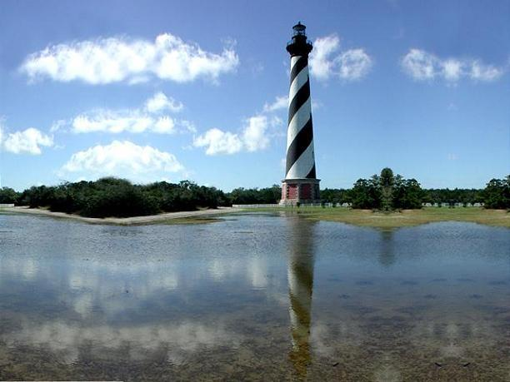
Figurative language is the use of words that go beyond their ordinary meanings. Figurative language requires you to use your imagination to figure out the author's meaning.
The water’s reflection was like the sun on glass.

Slide 3
SIMILE-A figure of speech comparing two different things using the words “like” or “as.”
After the football game, the boy was so sore he walked
like a toy soldier.

Slide 4
METAPHOR-A figure of speech comparing two different things without using the words “like” or “as.”
Stars are buttons off the
angels’ gowns.

Slide 5
Onomatopoeia-a word or words that imitate a sound
The click, click, click of the computer keys gave Mrs. Jones a headache.

Slide 6
Personification-giving human characteristics to things that are not human
The moonlight walked across the water.

Slide 7
HYPERBOLE-figurative language where exaggeration is used for emphasis
Our teacher is so old she probably taught cavemen how to make a wheel.

Slide 8
Alliteration-figurative language using the repetition of consonant sounds
Cop Curt wrote Wanda the Witch a speeding ticket. She was flying and flipping over the fifty-five mile an hour limit.

Slide 9
Bang, clang, and hiss are examples of what type of figurative language?

Slide 10
ONOMATOPOEIA

Slide 11
What type of figurative language is the following sentence?
Helga hangs handkerchiefs on the line.

Slide 12
ALLITERATION

Slide 13
What type of figurative language is the following sentence?
The boy could swim like a fish.

Slide 14
SIMILE

Slide 15
What type of figurative language is used in the following sentence?
John is a mountain
on the field.

Slide 16
METAPHOR

Slide 17
What type of figurative language is used in the following sentence?
Jimmy is so skinny, a skeleton looks fatter than he does!

Slide 18
HYPERBOLE

Slide 19
What type of figurative language is the following sentence?
The trees danced by the shore.

Slide 20
Personification

Slide 21
THE
END

