Slide 1
ZIP!
BAM!
ONOMATOPOEIA:
POW!
ONOMATOPOEIA:
IT’S EASY!
IT’S EASY!
SPLAT!
FIZZ!
MOO!
POP!

Slide 2
WE BEGIN OUR STUDY BY ASKING A SIMPLE QUESTION…
SO, WHAT EXACTLY
IS ONOMATOPOEIA?
LET’S FIND OUT!

Slide 3
THE DEFINITION MAY SEEM CONFUSING, BUT DON’T WORRY BECAUSE…
DEFINITION: ONOMAT0P0EIA ARE SPECIAL WORDS THAT SOUND LIKE THE NOISES MADE BY THE THINGS THAT THEY NAME OR DESCRIBE.
…ONOMATOPOEIA IS EASY!!!

Slide 4
LET’S TAKE A LOOK AT SOME EXAMPLES TO SEE JUST HOW EASY ONOMATOPOEIA IS!

Slide 5
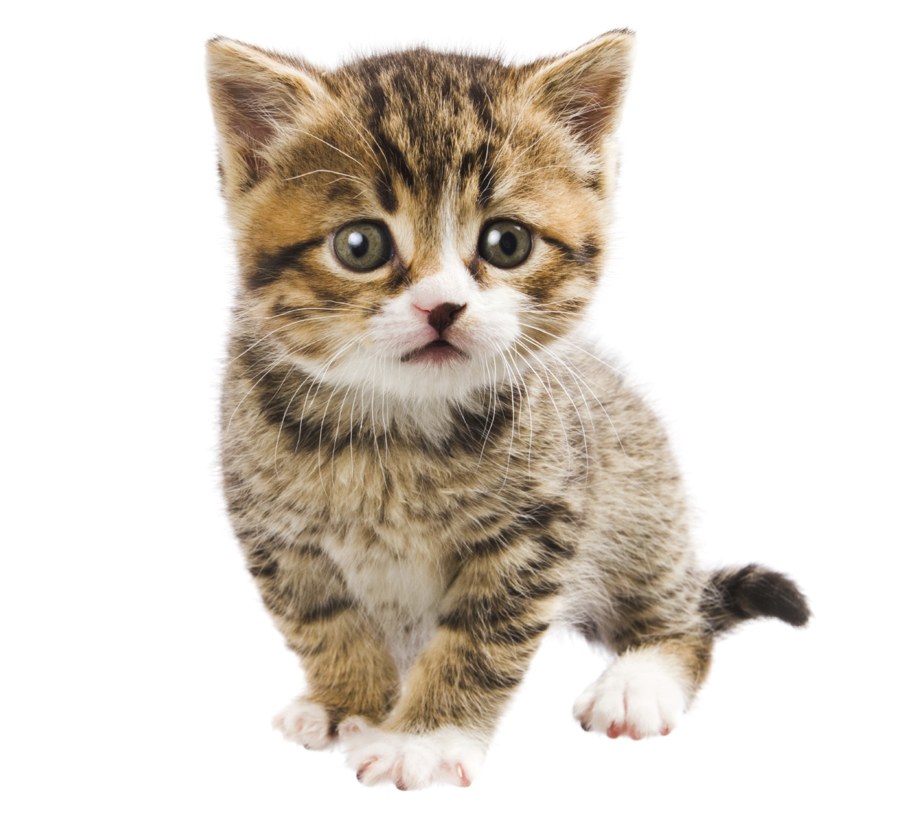
Example #1
Meow.
MEOW IS AN EXAMPLE OF ONOMATOPOEIA BECAUSE IT REMINDS US OF THE SOUND A KITTEN MAKES WHEN IT MEOWS.

Slide 6
LET’S TAKE A LOOK AT ANOTHER EXAMPLE!
LET’S TAKE A LOOK AT ANOTHER EXAMPLE!

Slide 7
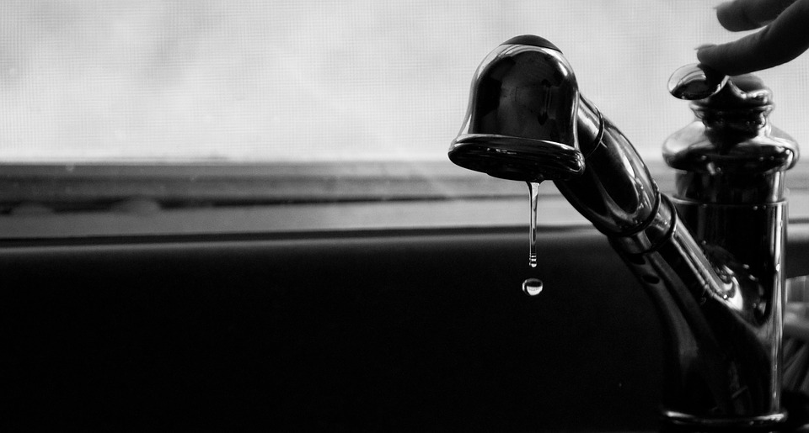
Example #2
DRIP IS AN EXAMPLE OF ONOMATOPOEIA BECAUSE IT REMINDS US OF THE SOUND THAT DRIPPING WATER MAKES.
Drip

Slide 8
LET’S TAKE A LOOK AT ANOTHER EXAMPLE!
LET’S TAKE A LOOK AT ANOTHER EXAMPLE!

Slide 9
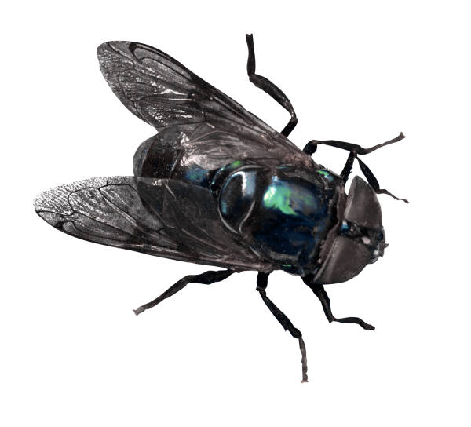
Example #3
BUZZ IS AN EXAMPLE OF OMOMATOPOEIA BECAUSE THE “Z” SOUND AT THE END OF THE WORD REMINDS US OF THE NOISE MADE BY FLYING INSECTS.
Buzz
LET’S LOOK AT SOME OTHER THINGS THAT BUZZ!

Slide 10
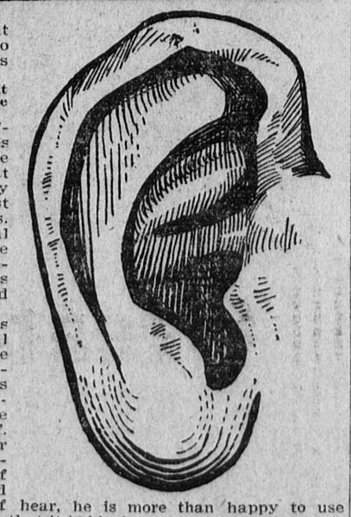
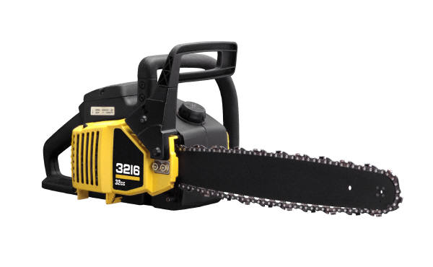
Buzz #2
THE LOUD BUZZ OF THE CHAINSAW HURT MY EARS!

Slide 11
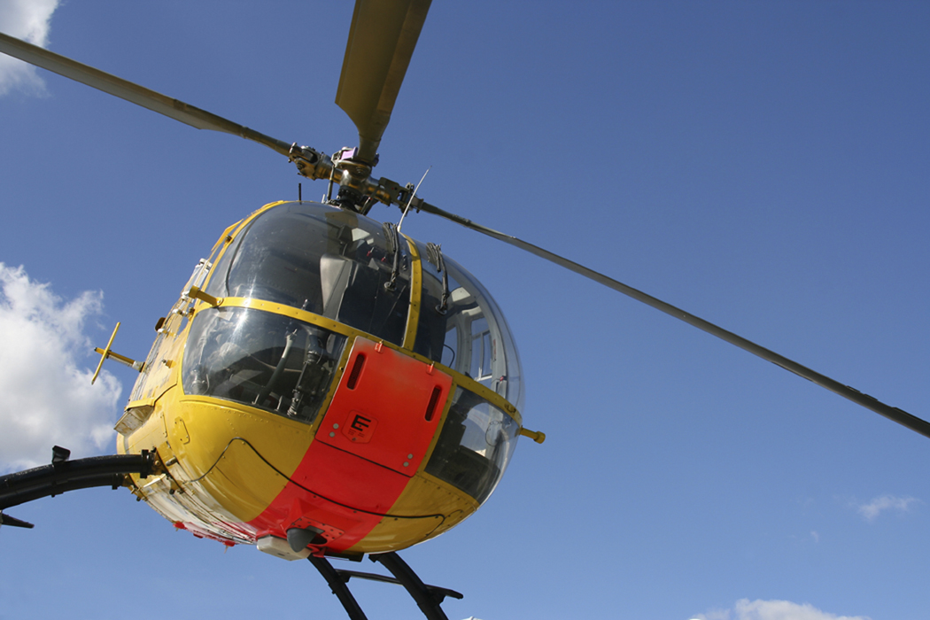
Buzz #3
THE HELICOPTER BUZZED OVERHEAD.

Slide 12
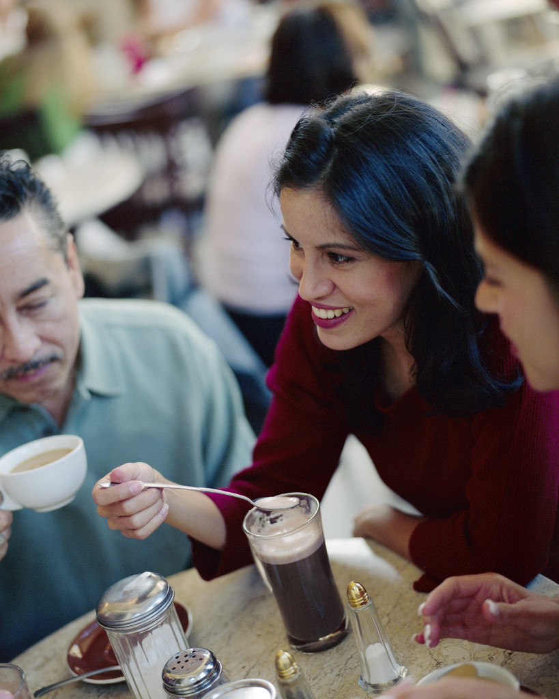
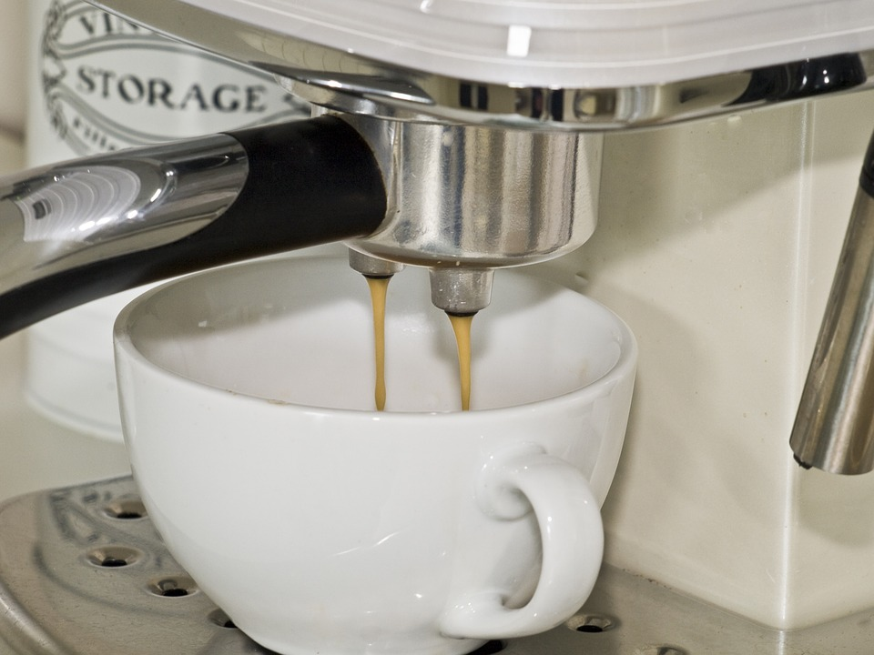
Buzz #4
THE BUSY CAFÉ BUZZED WITH ACTIVITY.

Slide 13
CHAINSAWS,HELICOPTERS, AND BUSY CAFÉS DO NOT MAKE THE SAME KIND OF BUZZ. CONTEXT IS IMPORTANT.
BUZZ!
BUZZ!
ONOMATOPOEIA IS EASY, ISN’T IT? LET’S WRAP THIS LESSON UP WITH A FEW QUESTIONS THAT WILL GIVE YOU A CHANCE TO SHOW OFF WHAT YOU KNOW.
BUZZ!

Slide 14
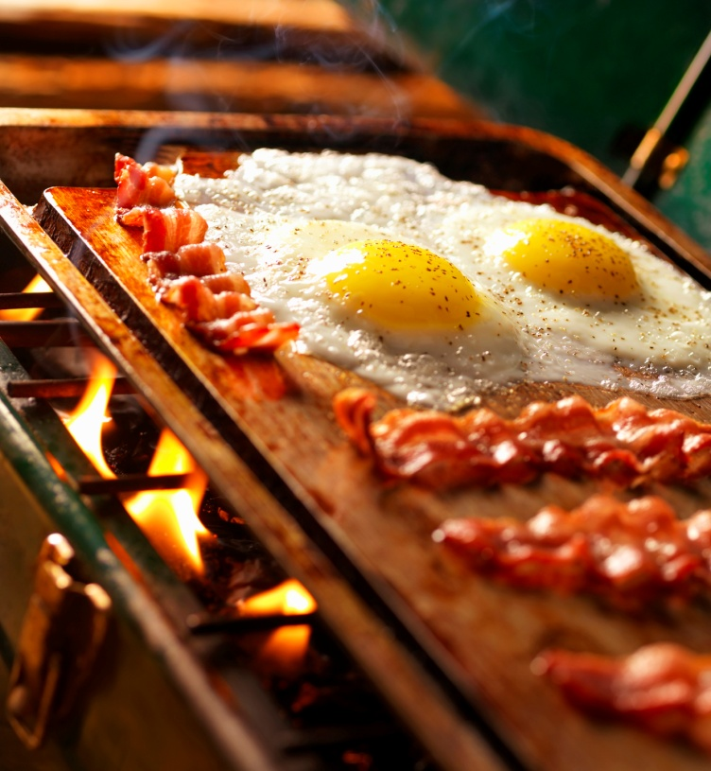
SELECT AN EXAMPLE OF ONOMATOPOEIA THAT CORRECTLY COMPLETES THE SENTENCE. CLICK ON THE ANSWER.
1.) THE BACON AND EGGS ______________ ON THE
HOT GRIDDLE.
A.) COOKED
B.) SIZZLED
C.) FRIED
D.) BURNED

Slide 15
GO BACK!
GO FORWARD!

Slide 16
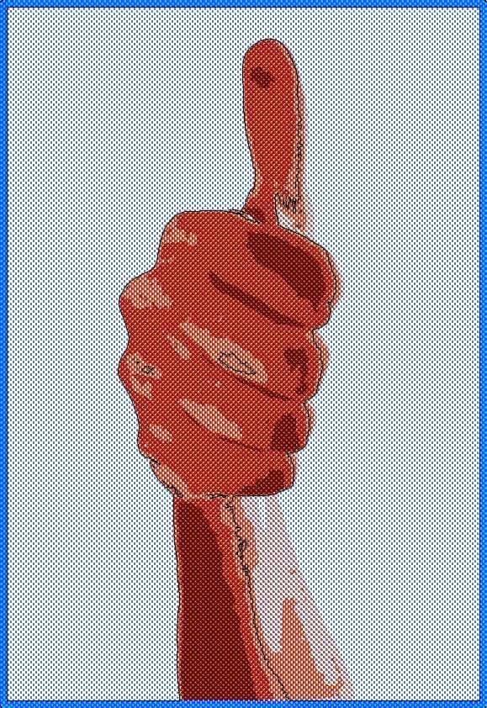
You got it!
GO FORWARD!

Slide 17
SELECT AN EXAMPLE OF ONOMATOPOEIA THAT CORRECTLY COMPLETES THE SENTENCE. CLICK ON THE ANSWER.
2.) PEOPLE ______________ AT THE DRIVER WHO
WAS GOING THE WRONG WAY.
A.) WAVED
B.) GESTURED
C.) HONKED
D.) POINTED

Slide 18
GO BACK!
GO FORWARD!

Slide 19
You got it!
GO FORWARD!

Slide 20
SELECT AN EXAMPLE OF ONOMATOPOEIA THAT CORRECTLY COMPLETES THE SENTENCE. CLICK ON THE ANSWER.
3.) THE HEAVY DOOR ______________ AS IT SLOWLY
OPENED.
A.) MOVED
B.) CREAKED
C.) SLID
D.) SWUNG

Slide 21
GO BACK!
GO FORWARD!

Slide 22
You got it!
GO FORWARD!

Slide 23
THE END
(You’ve been a wonderful audience.)

