Slide 1
The Outsiders
S.E. Hinton

Slide 2
About the Novel
Set in the 1960s in Tulsa, Oklahoma
Tells the story of class conflict between rich and poor teenagers
Some violence

Slide 3
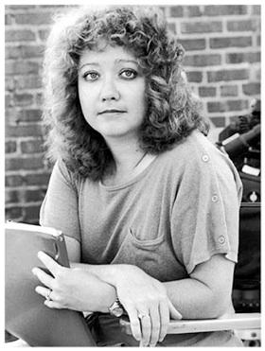
S.E. Hinton
Best known for “The Outsiders”
Wrote her first novel as a high
school student
Female convinced to use initials instead of her name so audience might think she was male

Slide 4
Greasers
Long, greasy hair
From the “wrong” side of town (East side)
Poor
Reputation for getting into trouble
Streetwise
Low academics/expectations
Territorial
Carry blades (ready to fight)

Slide 5
Greasers
Ponyboy Curtis
Darry Curtis
Sodapop Curtis
Two-Bit Matthews
Steve Randle
Dallas Winston
Johnny Cade
Sandy

Slide 6
Socials (Socs)
Short, neat hair
From West side of town
Upper middle class/wealthy
Snobby
Smart/high academic achievement
Confident
High expectations from family/friends
Like to jump Greasers if they are alone

Slide 7
Socials (Socs)
Cherry
Marcia
Randy Adderson
Bob Sheldon
Paul Holden

Slide 8
Common Ground
Teeagers
Hate the other group
Loyal
Defined by image and expectations of the group as a whole

